Slide 1
Machine Learning Mini Project Title:-Mall Customer Segmentation
Participants:-
1.Ashish Verma Soni (RA1911042010102)
2.Mohd. Areeb Iqbal (RA1911042010095)
3.Harshvardhan Singh Rathore(RA1911042010072)

Slide 2
1.Introduction
Problem Statement
Customer Segmentation is a popular application of unsupervised learning. Using clustering, identify segments of customers to target the potential user base. They divide customers into groups according to common characteristics like gender, age, interests, and spending habits so they can market to each group effectively.
Use K-means clustering and also visualize the gender and age distributions. Then analyze their annual incomes and spending scores.

Slide 3
Introduction to Problem Statement
To make predictions and find the clusters of potential customers of the mall and thus find appropriate measures to increase the revenue of the mall is one of the prevailing applications of unsupervised learning.
For example, a group of customers have high income but their spending score (amount spent in the mall) is low so from the analysis we can convert such type of customers into potential customers (whose spending score is high) by using strategies like better advertising, accepting feedback and improving the quality of products.
To identify such customers, this project analyses and forms clusters based on different criteria which are discussed in the further sections.

Slide 4
2.Dataset
The dataset name is Mall_Customers.csv consists of 5 columns which are CustomerID, Gender, Age, Annual Income (k$), Spending Score (1-100) where Gender is a categorical value and rest allfeatures are numeric.
The size of the dataset is (200, 5) which is 200 rows and 5 columns

Slide 5
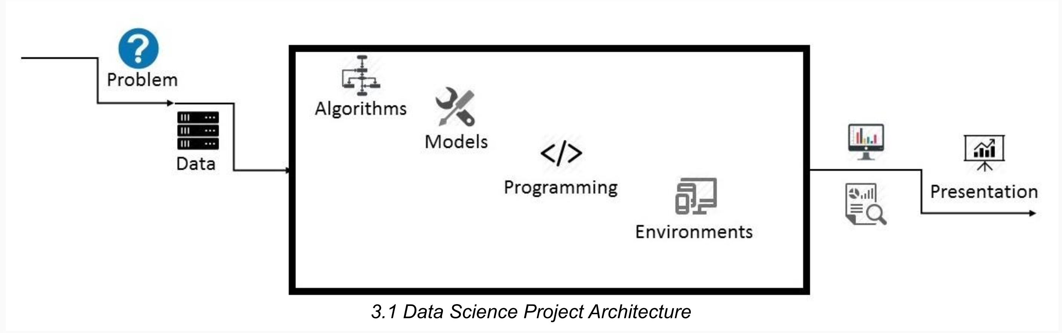
3.Proposed Method & Architecture Architecture Overview

Slide 6
Project Architecture
Data: The size of the dataset is (200, 5) which is 200 rows and 5 columns. Also on dataset does not contain any NULL or NaN values. Algorithms: K-means algorithm is used in this project to analyze and form clusters of customers based on their income and spending score features. Model: K-means model is used and is hyper tuned parameters like n_clusters=5 using elbow method to find the optimal number of clusters also init=’k-means++’ to avoid random initialization trap. Programming Language: Python 3.6 Environment (Libraries and Technologies): Numpy, Pandas, Matplotlib, Seaborn, Jupyter Notebook, Google Colab

Slide 7
4.Methodology
● Creating an approach to solve the given problem statement ● Exploring the dataset and obtaining useful insight from the same ● Cleaning the dataset by handling nan values, remove duplicate records, etc. ● Data Visualization used to obtain important information from the data ● Data Preprocessing is performed to make the data ready to fit the model this includes feature scaling, splitting the dataset into features and labels, etc. ● Model Building

Slide 8
5. Implementation and Analysis

Slide 9
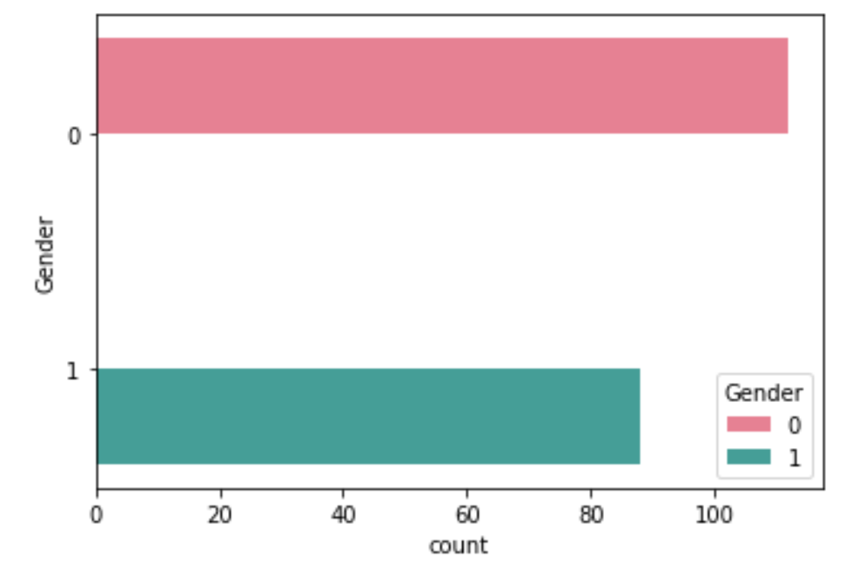
5.1 Gender Plot
Gender Plot Analysis:
From the Count plot, it is observed that the number of Female customers is more than the total number of Male customers.

Slide 10
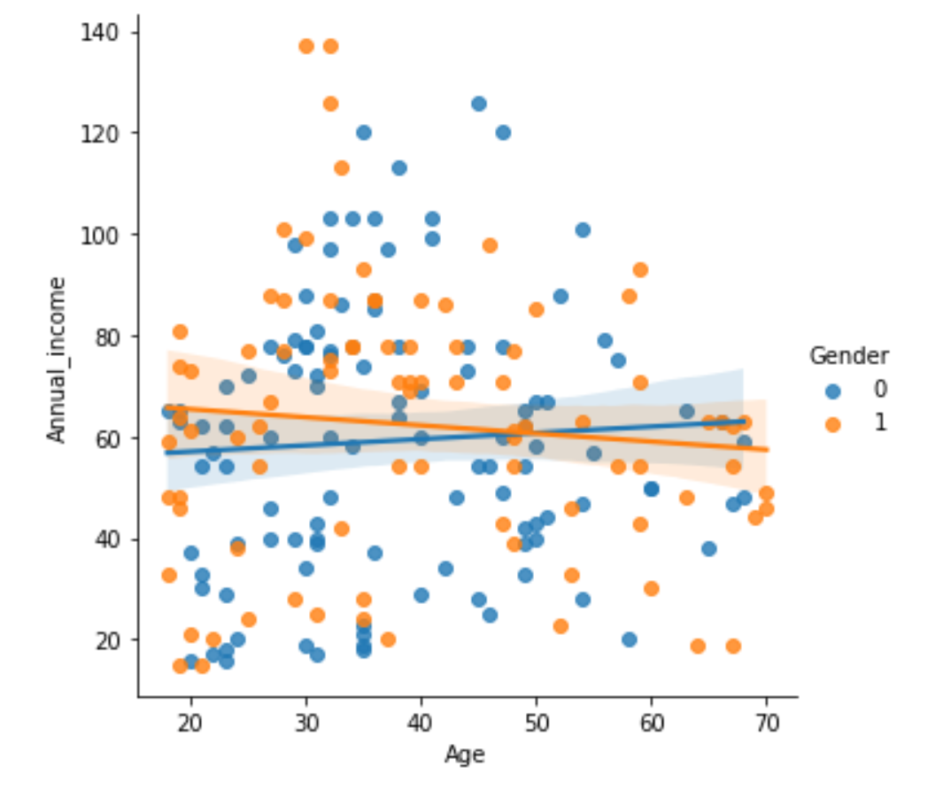
5.2 Age Plot
From the Histogram it is evident that there are 3 age groups that are more frequently shop at the mall, they are: 15-22 years, 30-40 years, and 45-50 years.

Slide 11
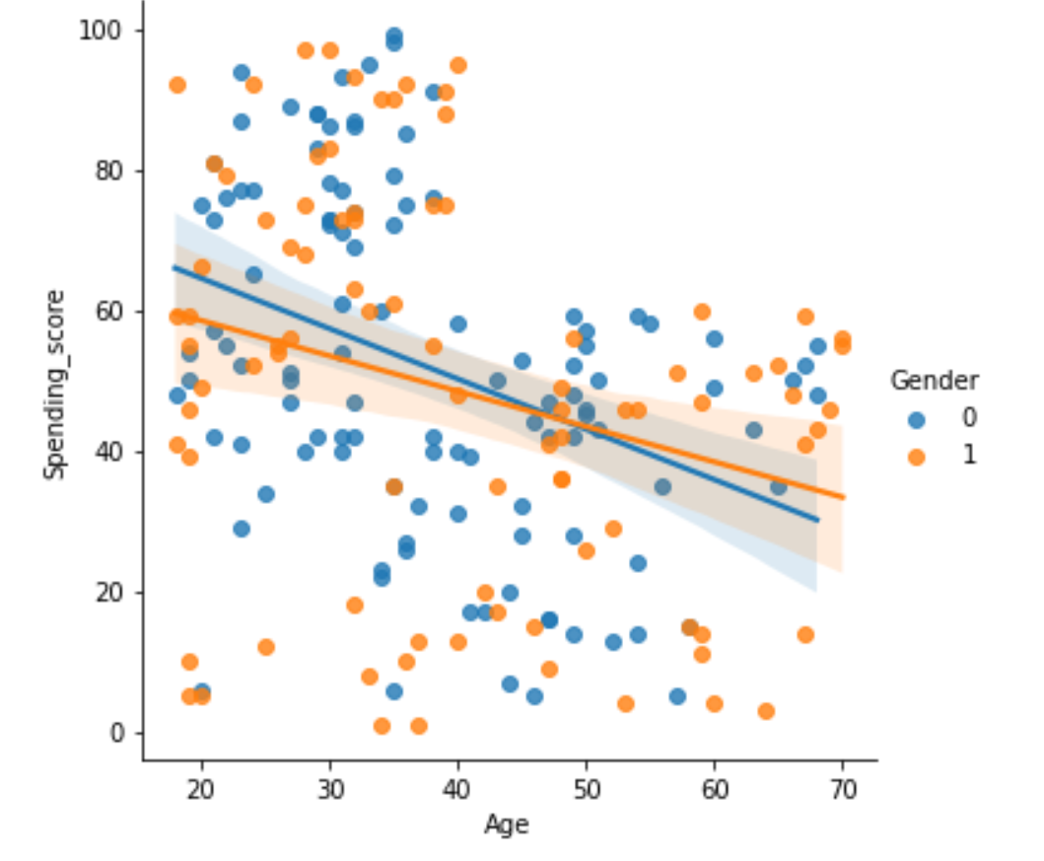
5.3 Age Vs Spending Score
Age Vs Spending Score Analysis
From the Age Vs Spending Score plot we observe that customers whose spending score is more than 65 have their Age in the range of 15-42 years. Also from the Scatter plot it is observed that customers whose spending score is more than 65 consists of more Females than Males.
The customers having average spending score ie: in the range of 40-60 consists of the age group of the range 15-75 years and the count of males and females in this age group is also approximately the same .

Slide 12
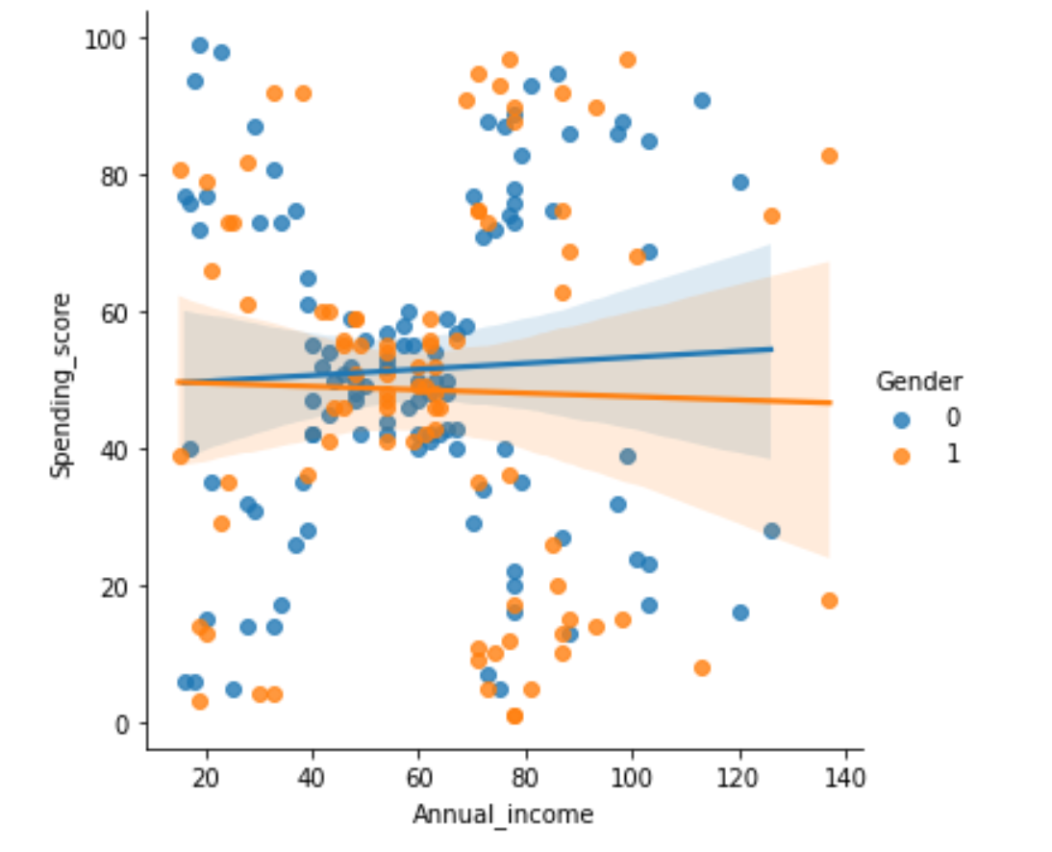
5.4 Annual Income Vs Spending Score
We observe that there are 5 clusters and can be categorized as:
a. High Income, High Spending Score (Top Right Cluster)
b. High Income, Low Spending Score (Bottom Right Cluster)
c. Average Income, Average Spending Score (Center Cluster)
d. Low Income, High Spending Score (Top Left Cluster)
e. Low Income, Low Spending Score (Bottom Left Cluster)

Slide 13
6. Conclusion
Clustering Analysis
High Income, High Spending Score (Cluster 5) - Target these customers by sending new product alerts which would lead to an increase in the revenue collected by the mall as they are loyal customers.
High Income, Low Spending Score (Cluster 2) - Target these customers by asking the feedback and advertising the product in a better way to convert them into Cluster 5 customers.
Average Income, Average Spending Score (Cluster 1) - May or may not target these groups of customers based on the policy of the mall.
Low Income, High Spending Score (Cluster 4) - Can target these set of customers by providing them with Low-cost EMI’s, etc.

Slide 14
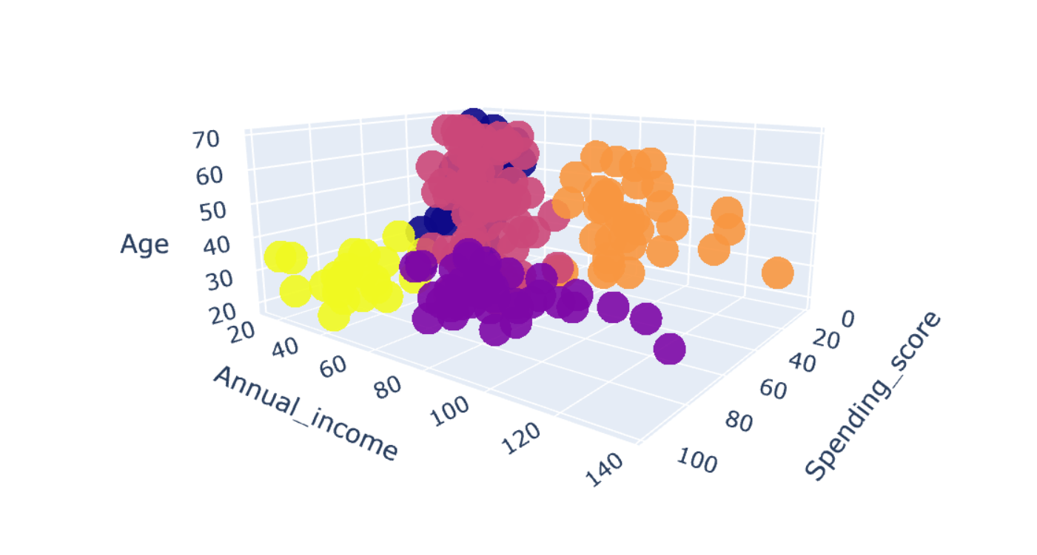

Slide 15
Thankyou!

